Slide 1
Lecture 15: Game Theory
Origins: Nash and von Neumann
Payoff matrices
Nash Equilibrium
Classic games
The unique number game

Slide 2
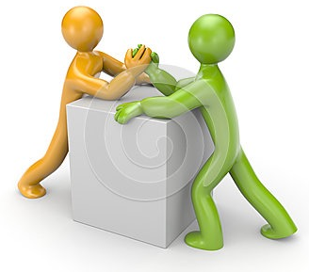

What is game theory?
A framework for studying social interaction and decision-making
Started in mathematics, then economics, but is used widely, e.g. in evolutionary biology

Slide 3

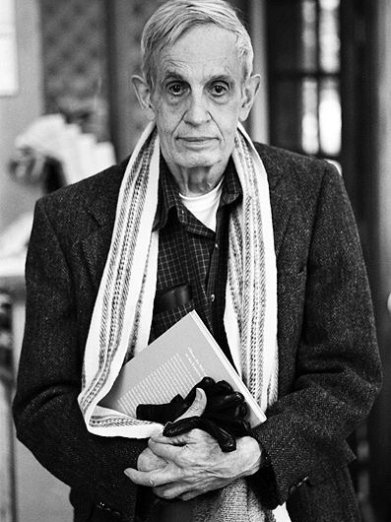
John Forbes Nash, Jr.
PhD thesis, Princeton (1950) 27 pages long
Theses need not be long!
[This is also true for senior theses!]

Slide 4

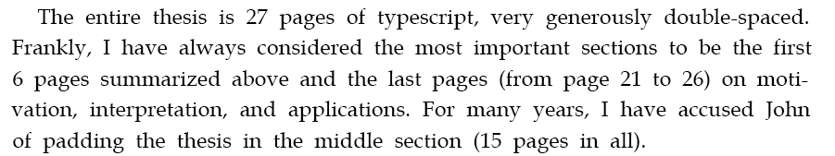
Kuhn’s description of his thesis, at the awarding of Nash’s Nobel prize in 1994
Notes:
Arrived at Princeton for graduate school at age 20. One sentence LOR from prof at Carnegie “This man is a genius”
Results for which he is honored for Nobel were obtained in his first 14 months of graduate school.

Slide 5
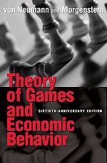

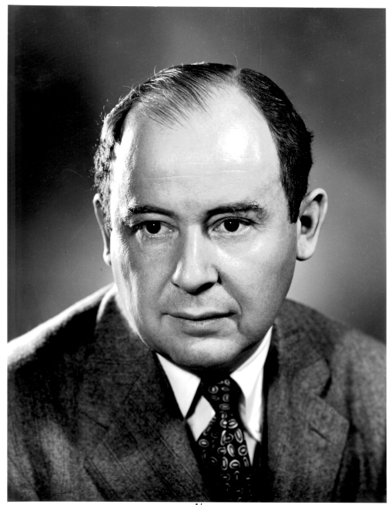
Original Formulation of Game Theory
(1944)
Nash’s work built on von Neumann’s original formulation.
His thesis was written as several papers—one very mathematical,
the rest more explanatory

Slide 6





Two Player Game: my payoff
 | You: Strategy 1 | You: Strategy 2
Me: Strategy 1 | 5 | 3
Me: Strategy 2 | 4 | 2
$$a_{ij}$$
$$a_{11}=5$$
$$a_{21}=3$$
$$a_{12}=4$$
$$a_{22}=2$$
My payoff matrix: Gives me a reward, given the adoption of a strategy.
Other player has a payoffs given their strategies
Notes:
Change this to one where P1 and P2 have dominant strategies

Slide 7

Two Player Game: your payoff
 | You: Strategy 1 | You: Strategy 2
Me: Strategy 1 | 3 | 4
Me: Strategy 1 | 4 | 5
$$b_{ij}$$
Your payoff matrix: Gives you a reward, given the adoption of a strategy.

Slide 8
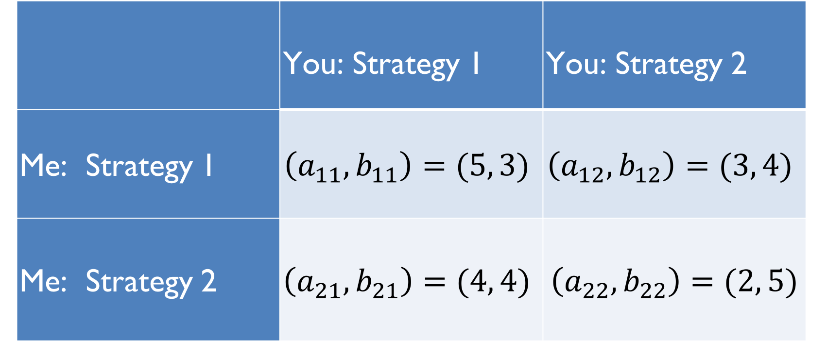
Two Player Game
 | You: Strategy 1 | You: Strategy 2
Me: Strategy 1 | $$\left(a_{11},b_{11}\right)=(5, 3)$$ | $$\left(a_{12},b_{12}\right)=(3, 4)$$
Me: Strategy 2 | $$\left(a_{21},b_{21}\right)=(4, 4)$$ | $$\left(a_{22},b_{22}\right)=(2, 5)$$

Slide 9
Two Player Game
How should I play?
 | You: Strategy 1 | You: Strategy 2
Me: Strategy 1 | $$\left(a_{11},b_{11}\right)=(5, 3)$$ | $$\left(a_{12},b_{12}\right)=(3, 4)$$
Me: Strategy 2 | $$\left(a_{21},b_{21}\right)=(4, 4)$$ | $$\left(a_{22},b_{22}\right)=(2, 5)$$

Slide 10
Two Player Game
How should I play?
 | You: Strategy 1 | You: Strategy 2
Me: Strategy 1 | $$\left(a_{11},b_{11}\right)=(5, 3)$$ | $$\left(a_{12},b_{12}\right)=(3, 4)$$
Me: Strategy 2 | $$\left(a_{21},b_{21}\right)=(4, 4)$$ | $$\left(a_{22},b_{22}\right)=(2, 5)$$
If you choose strategy 1, then I should choose strategy 1
If you choose strategy 2, then I should choose strategy 1

Slide 11
Two Player Game
How should I play?
 | You: Strategy 1 | You: Strategy 2
Me: Strategy 1 | $$\left(a_{11},b_{11}\right)=(5, 3)$$ | $$\left(a_{12},b_{12}\right)=(3, 4)$$
Me: Strategy 2 | $$\left(a_{21},b_{21}\right)=(4, 4)$$ | $$\left(a_{22},b_{22}\right)=(2, 5)$$
For me, strategy 1 dominates over strategy 2
For me, strategy $i$ dominates strategy $j$ if $a_{ij}≥a_{kj}$ for all $j$
Notes:
I should always play strategy 1

Slide 12
Two Player Game
How should you play?
 | You: Strategy 1 | You: Strategy 2
Me: Strategy 1 | $$\left(a_{11},b_{11}\right)=(5, 3)$$ | $$\left(a_{12},b_{12}\right)=(3, 4)$$
Me: Strategy 2 | $$\left(a_{21},b_{21}\right)=(4, 4)$$ | $$\left(a_{22},b_{22}\right)=(2, 5)$$
For you, strategy 2 dominates over strategy 1
For you, strategy $j$ dominates strategy $l$ if $b_{ij}≥b_{il}$ for all $j$

Slide 13
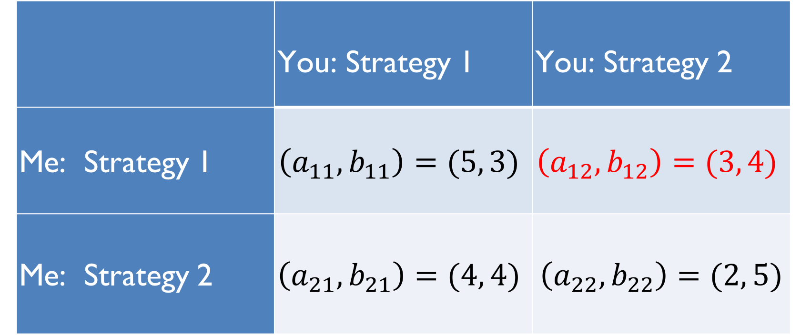
Dominant Strategy Equilibrium
 | You: Strategy 1 | You: Strategy 2
Me: Strategy 1 | $$\left(a_{11},b_{11}\right)=(5, 3)$$ | $$\left(a_{12},b_{12}\right)=(3, 4)$$
Me: Strategy 2 | $$\left(a_{21},b_{21}\right)=(4, 4)$$ | $$\left(a_{22},b_{22}\right)=(2, 5)$$
Both players play their dominant strategies.
Notes:
(aij, bij) is an equilibrium if aij is the largest element akj in column j and bij is the largest element bil in row I
Strategy ij is an equilibrium if (aij, bij) has the following property: aij is the largest element akj in column j, and bij is the largest element in row i. If this exists then pure strategy is optimal solution to game. If it doesn’t exist then players must play mixed strategies.

Slide 14
Dominant Strategy Equilibrium
 | You: Strategy 1 | You: Strategy 2
Me: Strategy 1 | $$\left(a_{11},b_{11}\right)=(5, 3)$$ | $$\left(a_{12},b_{12}\right)=(3, 4)$$
Me: Strategy 2 | $$\left(a_{21},b_{21}\right)=(4, 4)$$ | $$\left(a_{22},b_{22}\right)=(2, 5)$$
Example of a Nash Equilibrium, each strategy is best for the respective player.
Neither player can improve by unilaterally changing strategy.
Notes:
(aij, bij) is an equilibrium if aij is the largest element akj in column j and bij is the largest element bil in row I
Strategy ij is an equilibrium if (aij, bij) has the following property: aij is the largest element akj in column j, and bij is the largest element in row i. If this exists then pure strategy is optimal solution to game. If it doesn’t exist then players must play mixed strategies.

Slide 15
Another game
 | You: Strategy 1 | You: Strategy 2
Me: Strategy 1 | (2, 1) | (0,0)
Me: Strategy 2 | (0,0) | (1,1)
Does either player have a dominant strategy?

Slide 16
Another game
 | You: Strategy 1 | You: Strategy 2
Me: Strategy 1 | (2, 1) | (0,0)
Me: Strategy 2 | (0,0) | (1,1)
No player has a dominant strategy.
Two Nash Equilibria. Neither player can improve payoff by unilaterally changing strategy.

Slide 17
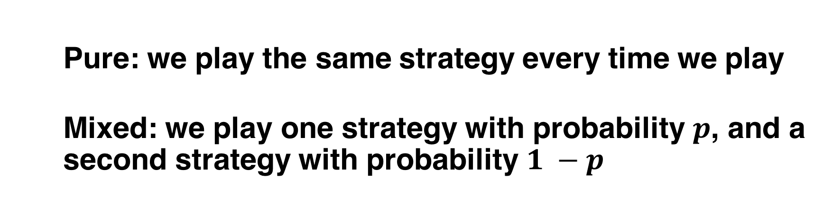
Fundamental Questions
What should I do? What maximizes my payoff?
What strategy?
Pure: we play the same strategy every time we play
Mixed: we play one strategy with probability $p$, and a second strategy with probability $1 −p$
Notes:
A pure strategy is one where, each time the players play the game, they choose the same strategy. A mixed strategy is one where the players introduce a random element in their choice of a strategy, thus leaving the opponent guessing.
A pure strategy provides a complete definition of how a player will play a game. In particular, it determines the move a player will make for any situation he or she could face. A player's strategy set is the set of pure strategies available to that player.
A mixed strategy is an assignment of a probability to each pure strategy. This allows for a player to randomly select a pure strategy. Since probabilities are continuous, there are infinitely many mixed strategies available to a player.
Of course, one can regard a pure strategy as a degenerate case of a mixed strategy, in which that particular pure strategy is selected with probability 1 and every other strategy with probability 0.

Slide 18
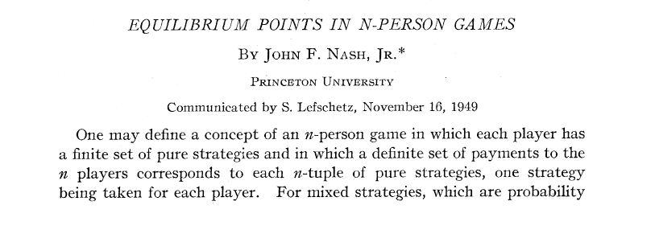
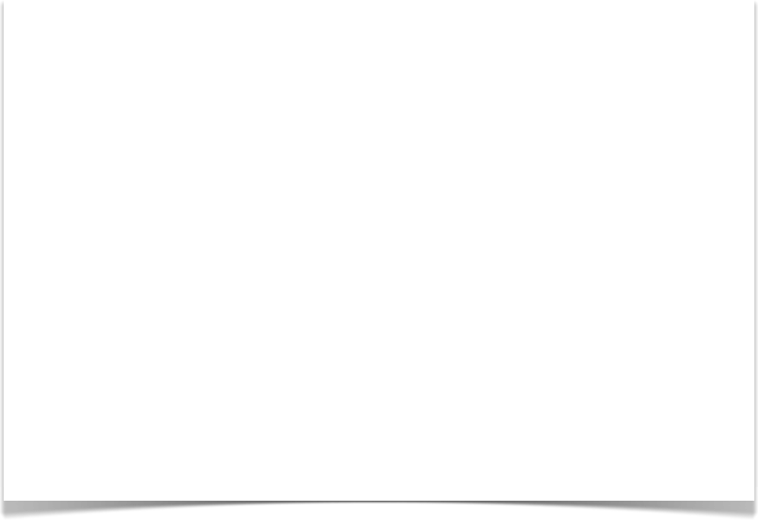
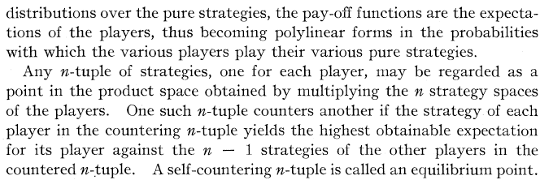
The Mathematical Paper
Note: This is basically the whole paper!
It relies on the notion of “fixed point theorems” (from analysis)
Notes:
The main result is the definition of a Nash Equilibrium and proof of its existence

Slide 19
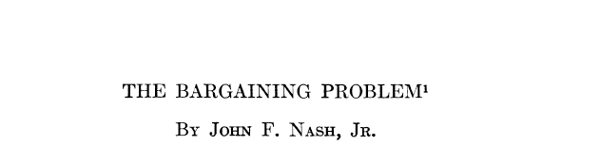

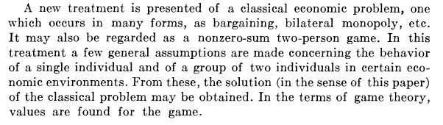
Less Mathematical Papers
“Values are found for the game”
Notes:
2-person games where the players' interests are completely opposed are called zero-sum or constant-sum games: one player's gain is the other player's loss.

Slide 20
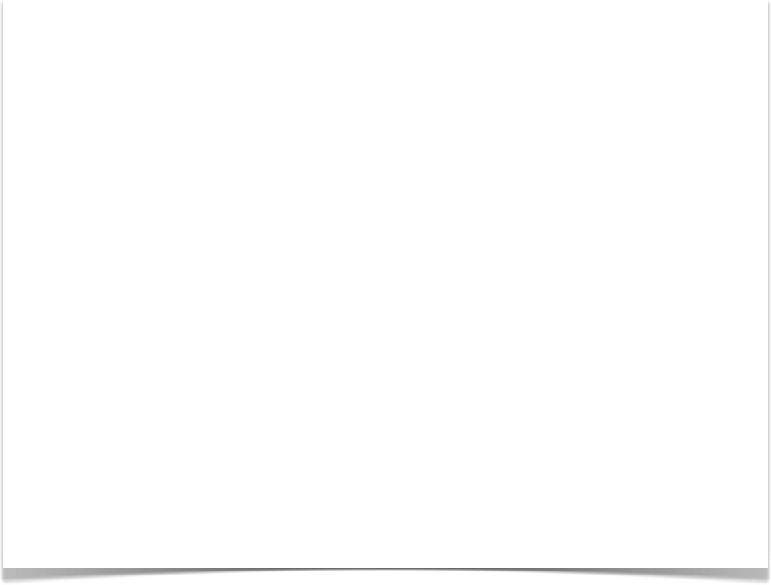
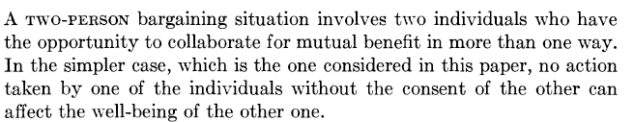
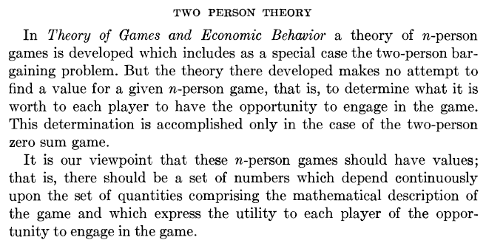

Slide 21

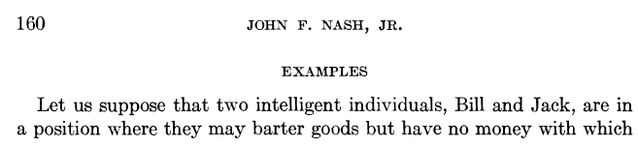
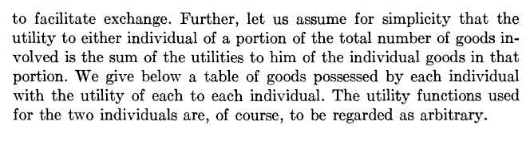
Nash’s Bargaining Example

Slide 22

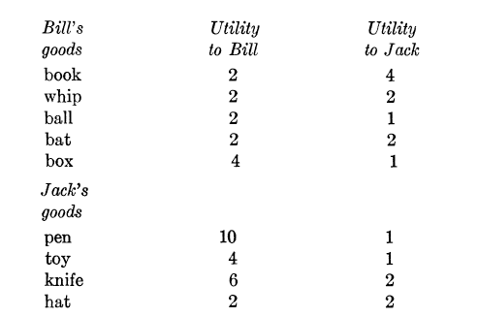
Example:

Slide 23

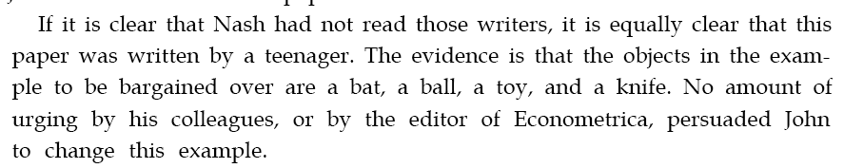
Example:
Kuhn:

Slide 24
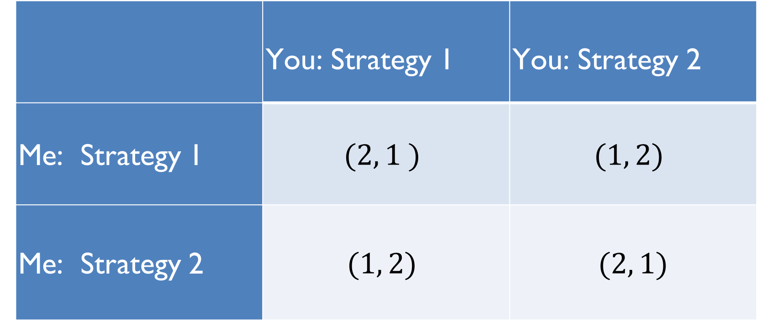
Another game
 | You: Strategy 1 | You: Strategy 2
Me: Strategy 1 | $$(2, 1 )$$ | $$(1, 2)$$
Me: Strategy 2 | $$(1, 2)$$ | $$(2, 1)$$

Slide 25
Another game
 | You: Strategy 1 | You: Strategy 2
Me: Strategy 1 | $$(2, 1 )$$ | $$(1, 2)$$
Me: Strategy 2 | $$(1, 2)$$ | $$(2, 1)$$
If you choose strategy 1, then I choose strategy 1
If you choose strategy 2, then I choose strategy 2

Slide 26
Another game
 | You: Strategy 1 | You: Strategy 2
Me: Strategy 1 | $$(2, 1 )$$ | $$(1, 2)$$
Me: Strategy 2 | $$(1, 2)$$ | $$(2, 1)$$
If I choose strategy 1, then you choose strategy 2
If I choose strategy 2, then you choose strategy 1

Slide 27
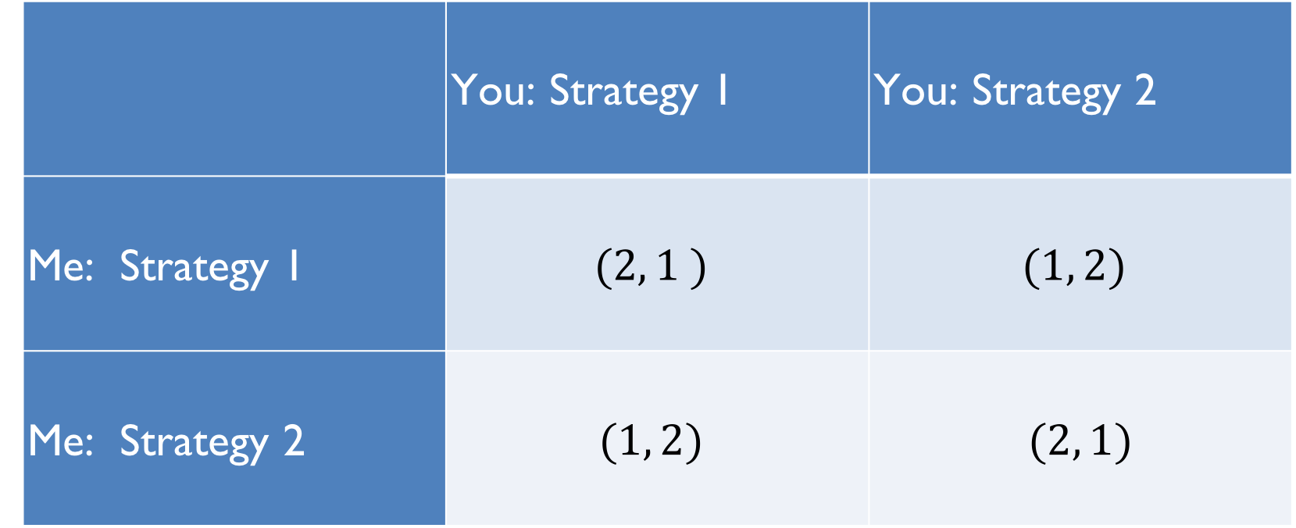
Another game
 | You: Strategy 1 | You: Strategy 2
Me: Strategy 1 | $$(2, 1 )$$ | $$(1, 2)$$
Me: Strategy 2 | $$(1, 2)$$ | $$(2, 1)$$
No Nash Equilibria

Slide 28
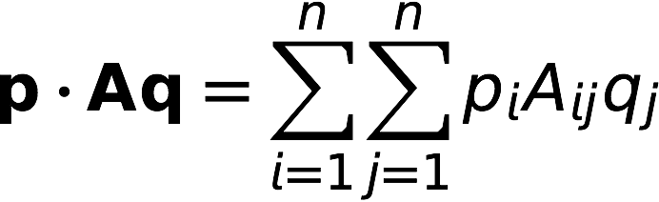

Nash’s Main Theorem
There is always a Nash Equilibrium using mixed strategies!
He explains his proof in words in his short paper (1 page).
In equations, payoff for strategy p with payoff matrix A against strategy q is
For any A, there is at least one strategy q such that for all opposing strategies p
Here q is a Nash equilibrium.

Slide 29
Do such games appear in real life?

Slide 30
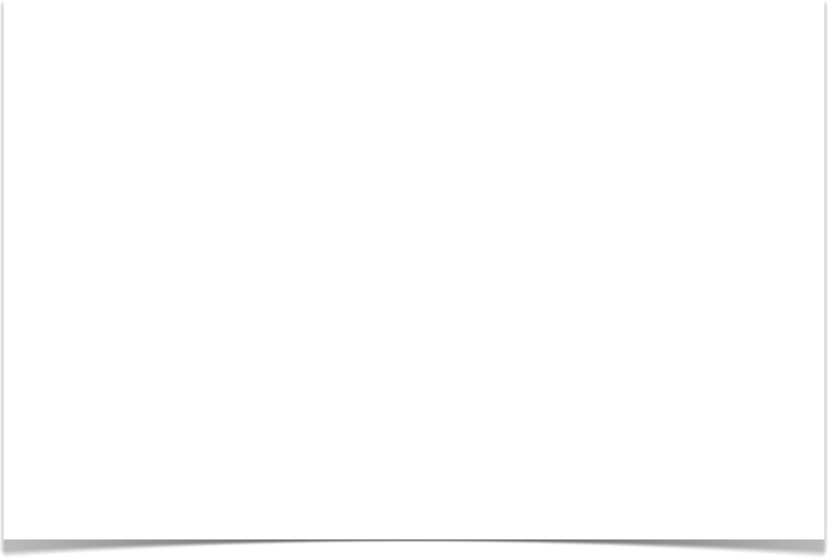
Bertrand Russell, 1959
Since the nuclear stalemate became apparent, the Governments of East and West have adopted the policy which Mr. Dulles calls ‘brinkmanship’. This is a policy adapted from a sport which, I am told, is practised by some youthful degenerates. This sport is called ‘Chicken!’. It is played by choosing a long straight road with a white line down the middle and starting two very fast cars towards each other from opposite ends. Each car is expected to keep the wheels of one side on the white line. As they approach each other, mutual destruction becomes more and more imminent. If one of them swerves from the white line before the other, the other, as he passes, shouts ‘Chicken!’, and the one who has swerved becomes an object of contempt. As played by irresponsible boys, this game is considered decadent and immoral, though only the lives of the players are risked. But when the game is played by eminent statesmen, who risk not only their own lives but those of many hundreds of millions of human beings, it is thought on both sides that the statesmen on one side are displaying a high degree of wisdom and courage, and only the statesmen on the other side are reprehensible. This, of course, is absurd. Both are to blame for playing such an incredibly dangerous game. The game may be played without misfortune a few times, but sooner or later it will come to be felt that loss of face is more dreadful than nuclear annihilation. The moment will come when neither side can face the derisive cry of ‘Chicken!’ from the other side. When that moment is come, the statesmen of both sides will plunge the world into destruction.[3]

Slide 31


The Chicken Game
Cars drive towards each other at high speeds on a single lane road.
Do I turn off the road, or keep going?
 | Go for it | Chicken
Go for it | -c | b
Chicken | -b | 0
My payoff matrix
-c = cost of crashing, c > 0
b = gain from winning, c > b > 0

Slide 32
The Chicken Game
My payoff matrix
 | Go for it | Chicken
Go for it | -c | b
Chicken | -b | 0
-c = cost of crashing, c > 0
b = gain from winning, c > b > 0
In a Nash equilibrium, neither player can unilaterally improve its payoff by changing strategies.
Are there Nash equilibria?
Discuss

Slide 33
The Chicken Game
 | Go for it | Chicken
Go for it | (-c, -c) | (b, -b)
Chicken | (-b, b) | (0, 0)
Full payoff matrix
-c = cost of crashing, c > 0
b = gain from winning, c > b > 0
In a Nash equilibrium, neither player can unilaterally improve its payoff by changing strategies.
Are there Nash equilibria?
YES: either (go for it, chicken) or (chicken, go for it)

Slide 34

The Prisoner’s Dilemma
Two prisoners committed a crime together. They are separated and cannot talk to each other.
The prosecutor offers each the same deal: confess, become a witness to the prosecution, and no jail time.
If one prisoner confesses while other does not, the first goes free and the second goes to jail for 10 years.
If both confess they will each go to jail for 7 years.
If neither confess they go to jail for 1 year (since nothing can be proven).

Slide 35
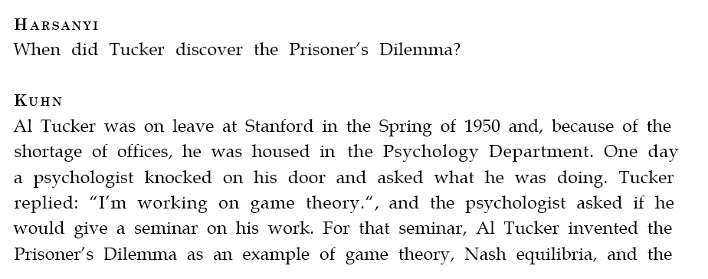

Discovered by Al Tucker, Nash’s PhD advisor

Slide 36
The Prisoner’s Dilemma
http://www.bbc.com/news/
 | Remain Silent | Confess
Remain Silent | (-1, -1) | (-10, 0)
Confess | (0, -10) | (-7, -7)
What should they do?
Discuss

Slide 37
The unique number game
Take n players
They each choose an integer from 0 to 99
The person who chose the lowest unique number wins

Slide 38
Two example games with five players
Player | A | B | C | D | E
Choice | 0 | 4 | 3 | 2 | 0
Player D wins
Player | A | B | C | D | E
Choice | 0 | 3 | 3 | 0 | 0
No unique number – draw

Slide 39
Let’s play!
We’ll give you five minutes to think and discuss general strategy
We want you to make a choice in secret, without cooperation with your neighbors
Write your choice and your name on the paper
We’ll collect all the guesses and determine the winner
The winner will be rewarded with chocolate

